Slide 1
Tool Use and Reactive Agents
Letting LLMs act with purpose
Notes:
Up until now, we’ve seen LLMs as great talkers — they can answer questions, summarize, write code — but they can’t do much on their own. Today we’re giving them purpose by introducing two big ideas: tools and ReAct agents.
Tools are the gadgets that extend what the model can do — calculators, search engines, database lookups. ReAct agents are the brains that decide when and how to use those tools.
Instead of guessing an answer, the agent can think, act, observe, and then answer with higher accuracy and confidence. By the end of this session, you’ll have seen both the raw, manual way of giving an LLM a tool and the easier, more powerful LangChain way — and you’ll watch your agent make decisions live.

Slide 2
Recap from Chapter 1
->
What are LLMs?
->
Met local LLM
->
Discussed Prompt Engineering
->
Build a Chatbot with Memory
->
Basic Agents definition
Notes:
Here’s what our journey looks like."
"We’ll start with a quick story of what are llms and how we even got to LLMs. Then we’ll meet a local LLM.
We will then control it’s behavior and
Then we’ll build a chatbot —
and make it smarter step-by-step until it becomes something more than just a chatbot:
it becomes an agent
"By the end, you’ll have the mental model and some code patterns to go further on your own."

Slide 3
Table of Contents
4
Sneak Peek: Under the Hood
5
Gadgets for Our Agents a.k.a Tools
6
Let’s Build some Gadgets and Use them.
12
The Detective’s Playbook - ReAct Agents
Notes:
Today, I want you all to be detectives with me.
Keep your eyes sharp, because our clues are hidden in the code.
Every snippet we run is like a piece of evidence — sometimes it tells the truth, sometimes it tries to trick us.
Your job is to inspect, question, and call out anything suspicious.
By the end, we’ll have solved the case together.

Slide 4
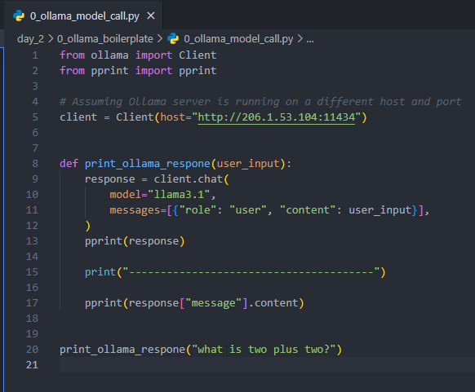
Sneak Peek: Under the Hood
Ollama library
What’s missing :
Multiple Retries
Readability
Graceful exception handling
Many more things
Notes:
LangChain isn’t magic—it’s a smart wrapper. Underneath, it still makes an HTTP call to your model. Here’s the bare-metal version in ~10 lines.”
"Here’s the raw Ollama client — no LangChain, just direct API calls. It’s pretty simple, right? We can send a prompt and get back a response. So the natural question is: if it’s already this easy, why do we even need LangChain? The answer is: for simple Q&A, maybe we don’t. But as soon as we want memory, tools, or complex reasoning, this approach starts to get messy — and that’s where LangChain shines. Keep this question in mind, because when we hit ‘tools,’ you’ll see why abstraction is not just convenience, but necessity."

Slide 5

What are Tools ?
LLMs = Smart Thinkers
Tools = Actions for those smart thinkers.
Python Functions + Metadata = Usable tools
Notes:
Alright, last time we met our LLMs and agents. Today, we’re going to give our agents something every superhero needs — gadgets.
Think of tools as the Batmobile, web shooters, or sonic screwdriver for our AI agents. Without them, an LLM is just a really good talker. With them, it becomes a doer.
📚 Definition — A tool is simply a function or capability the agent can call to get something done. The LLM can’t browse the web by itself, it can’t do heavy math, and it can’t look up your company’s latest sales numbers unless… we give it a tool that can.
💡 Why Tools Matter — LLMs are like your friend who can give you great advice… but doesn’t own a phone, can’t look anything up, and doesn’t have a calculator. A tool is that phone, that Google search bar, that calculator. It bridges the gap between reasoning and action.
Examples you’ll see today:
A search tool so the agent can look things up.
A calculator for math-heavy answers.
A database query tool to fetch real company data.
And once we give our agents tools, we can also teach them when to use them — which is where ReAct agents come in later.

Slide 6
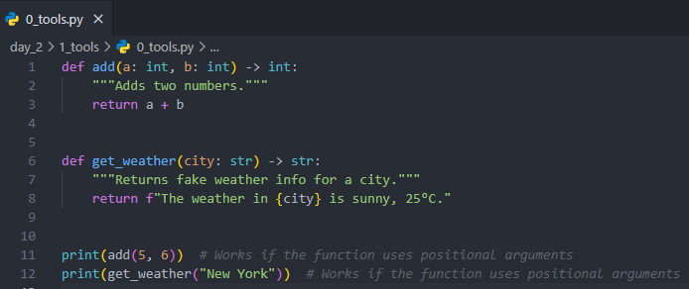
How to Create Tools?
Step 1 :
Write basic python functions.
Notes:
Let’s start with the simplest version — just a Python function.
Here’s a boring one: add two numbers.
And here’s a slightly more exciting one:
give fake weather for a city.
These are not tools yet — just functions.

Slide 7
Can Our LLM Use These Tools?
Short Answer : YES
Long Answer : It’s complicated.
Notes:
Okay, we’ve built our gadgets — Python functions. But can the LLM actually use them? Let’s try.
Here’s 1_tool_calling.py where we ask Ollama to use a tool.
What happens? It predicts a tool call — but doesn’t actually run it.
Remember: the LLM is a smart text predictor. It doesn’t execute functions, it just guesses what would happen.
“Alright, before we go further—big question: Can an LLM call a tool directly?” (Pause, take quick guesses—yes/no/maybe)
You: “Short answer: YES. Long answer: It’s complicated… and slightly painful without help.”
(Flip to code snippet)
You: “This is the bare metal Ollama way. We’re literally handing the model a tool definition in JSON and saying: ‘If you need it, call it.’ Here’s a weather tool. Just to give you a taste, notice:
You have to describe the tool in detail — name, description, parameters, required fields…
All in the exact schema the model expects. Miss one curly brace and… boom, error.”
(Run it live, show tool_calls in output.)

Slide 8
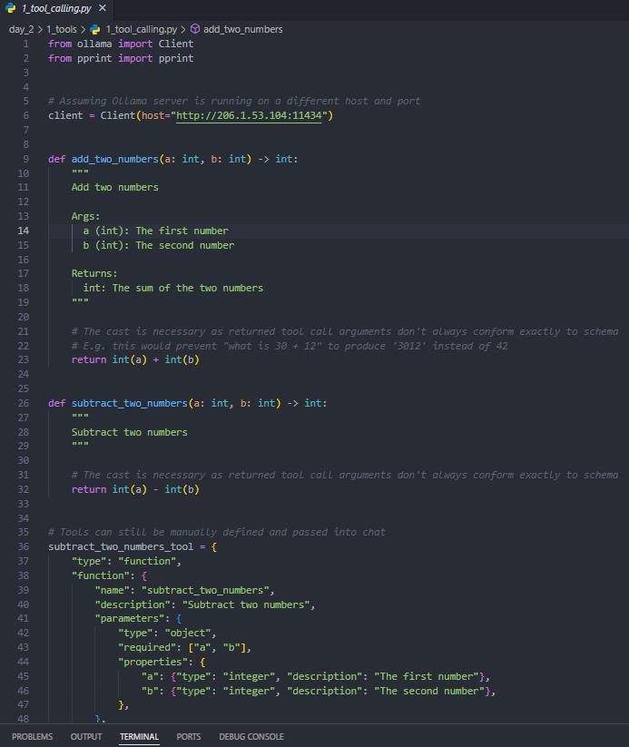
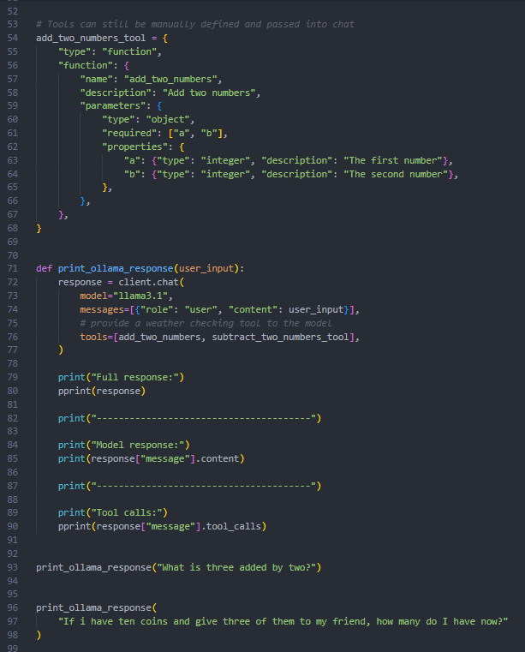
Can Our LLM Use These Tools?
Notes:
Too tiresome!!!!
You: “Now imagine adding a second tool—like a calculator. You’re copy-pasting another giant block of JSON. Then you have to manually check if the model called it, parse the arguments, run the tool yourself, feed the result back, and so on. And that’s before we even talk about chaining multiple tools or deciding when to use them.”
(Start typing the second tool into the tools list — maybe even let someone shout the tool name or function — to make it interactive.)
You: “This works. But it’s like building IKEA furniture without the instruction manual. You can do it, but it’s… not your Saturday night plan. That’s where LangChain comes in—it wraps all of this so you can just focus on defining the tool function and let the agent handle the when/why/how.”
Optional punchline slide after demo:
Title: “Without LangChain: You are the tool router.” Bullet: With LangChain: The agent is the tool router.

Slide 9
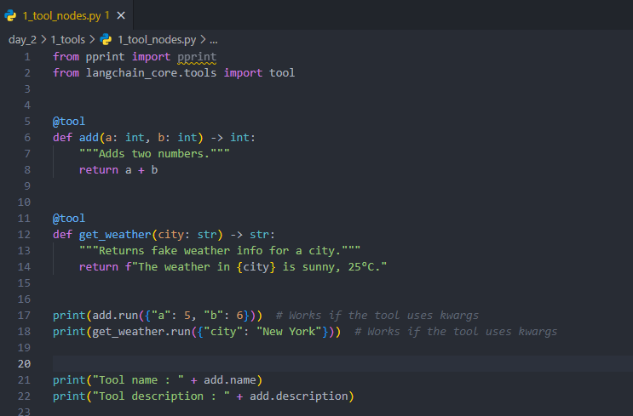
Tool Nodes to the Rescue
Wrap them as Tool Node
Use run or invoke method to call them
Notes:
Now, if we want the LLM to use them, we wrap them in LangChain’s @tool decorator.
This tells the agent: ‘Hey, here’s a tool you can use, here’s what it does, here’s how you call it.’
Once it’s decorated, we can check its name, description, and run it with parameters.
The agent will later do this automatically."
"Alright, enough of me showing off my tools.
Time for you to build one.
I’ve got a completely empty Python file here.
We’re going to make a tool together — you can copy me or go creative."
"Rules are simple: It can be as silly or serious as you want, but it has to take at least one parameter and return something useful (or funny).
The point is to practice adding the @tool decorator and writing a docstring the model can understand."
Make text in upper or lower case
Multiply
Date time

Slide 10
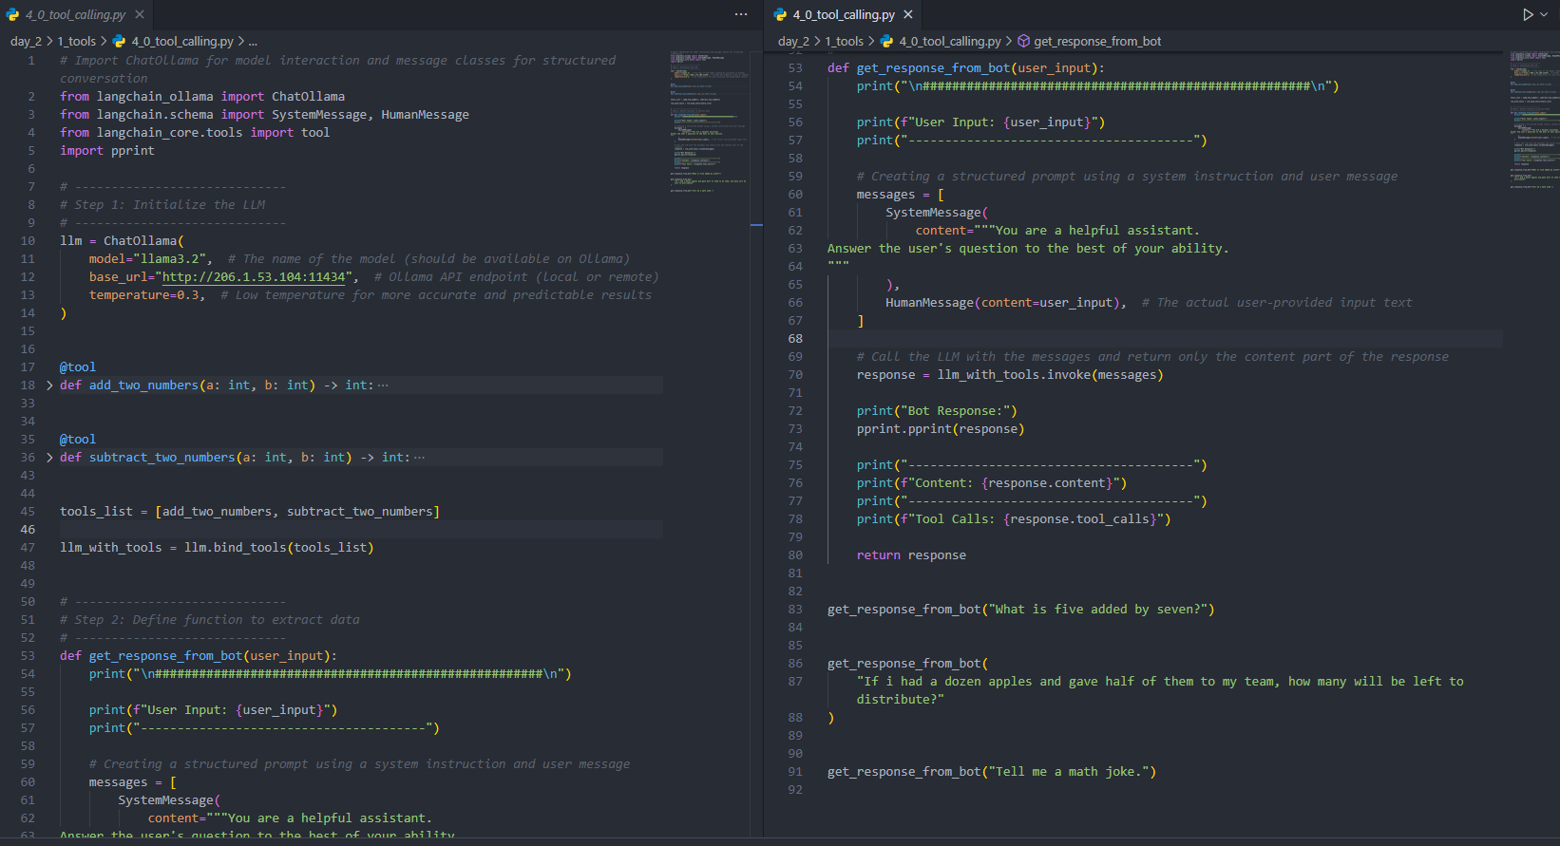
Calling Tools
LLM outputs: Tool Call
❌ No result
(yet)
Notes:
"Alright, let’s give it a try. In 4_0_tool_calling.py, we ask the LLM a math question. What happens? It calls the tool — yay! — but it doesn’t give us the answer. Why? Because it handed us the tool call, but nobody actually ran it."

Slide 11
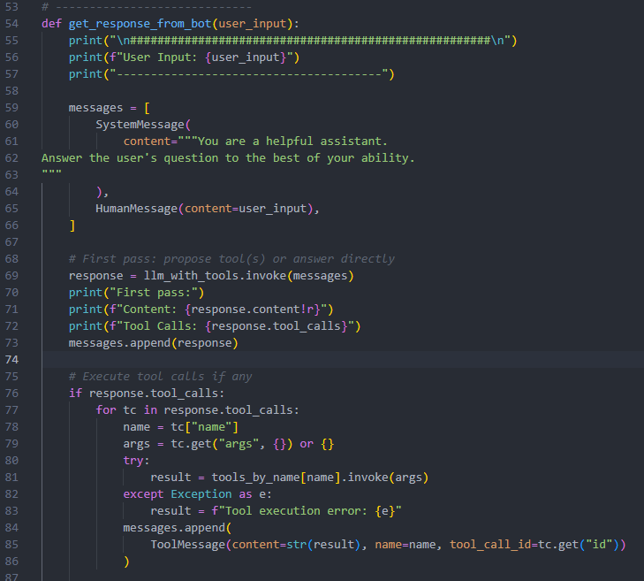
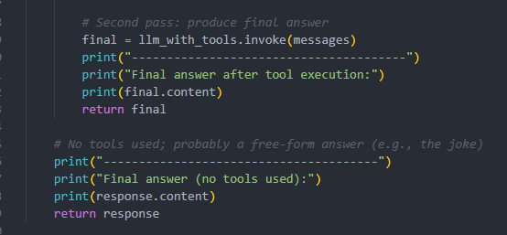
Calling Tools — Second Attempt
✅ Tool executes, result returned
😅 But… we had to manually pass tool messages
Notes:
So we fix it. In 4_1_tool_calling.py, we manually execute the tool call and pass the tool’s result back to the LLM. This works — the model gives the final answer. But notice how clunky this is: we’re handling tool messages, wiring them manually, passing responses back. Imagine doing this for 10 different tools, across multiple agents. It’s tiring.
So… is there a way to make this simpler? Hold that thought — because that’s where LangChain enters the story.
Out-of-order calls happen because the model isn’t executing a plan—it’s guessing.
We can nudge it with instructions like ‘First compute the sum, then subtract,’ or require variable names and intermediate results.
But… this is still brittle. We’re hand-holding every step and maintaining custom parsing.
What we really want is a pattern where the agent thinks → acts → observes → continues until it’s done—that’s ReAct.
Next, we’ll give the model a deliberate reasoning loop so it chooses the right tool, in the right order, with the right arguments.

Slide 12
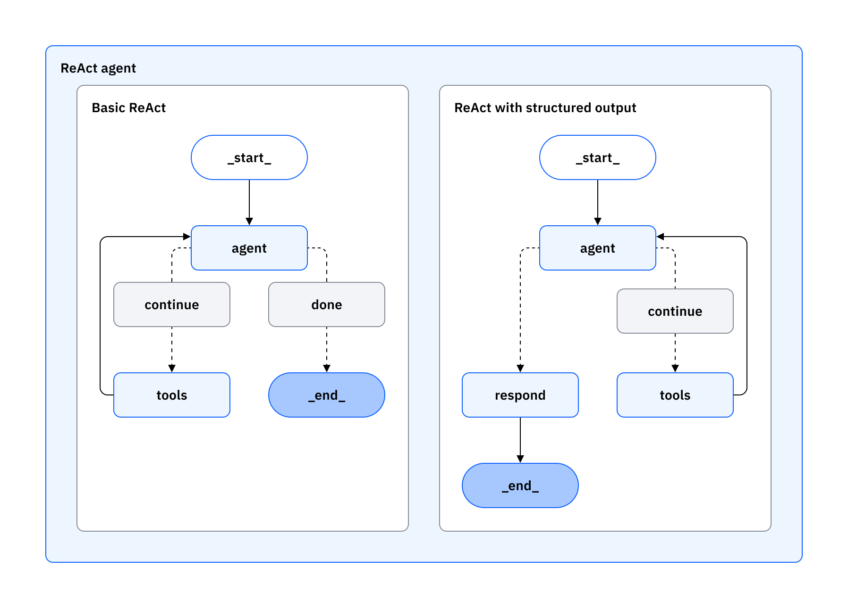
From LLM to Agent: The ReAct Pattern
🧠 Think step-by-step → decide if a tool is needed.
⚡ Act : call a tool
👀 Observe the result.
🔁 Repeat the loop until confident → Answer.
Notes:
Okay, our agent now has tools. But when should it use them? That’s where ReAct comes in: Reason + Act.
Think of a detective:
First, they think out loud: ‘Do I know this already? Or do I need to check something?’
If needed, they act: make a call (tool), check records (another tool), then observe the result.
They loop: reason → act → observe → reason… and finally answer.
ReAct makes the model’s process transparent and tool-savvy.
Instead of guessing, it decides: ‘I should call the calculator’ or ‘I already know this, answer directly.’
That keeps answers accurate and tool usage efficient.
We’ll wire up the tools we just made and watch the agent choose what to do—live.

Slide 13
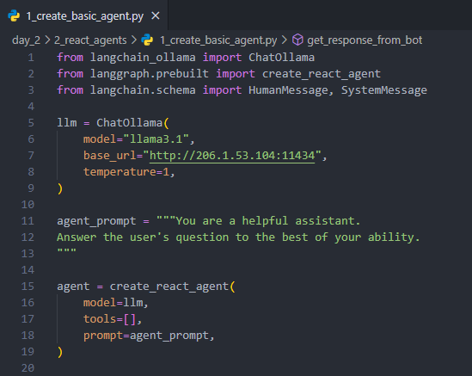
How do we build ReAct agent?
Create llm object.
Define tools if needed.
Create ReAct agent using create_react_agent method from langchain
Notes:
“Alright, let’s wire this up in three simple steps.
Step 1 — Create the LLM object. We start by initializing our model. In the code, that’s the ChatOllama call—notice I set the model name, base URL for the local runner, and temperature. Temperature controls creativity; I’m leaving it at 1 for the demo so you can see a bit of variety, but for tools I often go lower for reliability.
Step 2 — Define tools (if we need them). A ReAct agent can run without tools, but it shines when you give it capabilities like a calculator or a data lookup. I’m starting with an empty list so you can see the scaffolding first, then we’ll plug in a tool and watch the agent decide when to use it.
Step 3 — Create the ReAct agent. We pass the LLM, our (empty-for-now) tools list, and a short system prompt into create_react_agent. That gives us an agent that follows the ReAct loop: think → act (call a tool) → observe → answer.
To make the difference crystal clear, I’m running the same question two ways:
First with a plain bot: we send SystemMessage + HumanMessage straight to the LLM and print the answer.
Then with the agent: we hand the user input to the ReAct agent and print what it returns.
For a basic question like ‘What is the capital of France?’, both will likely answer ‘Paris’. The point here isn’t the result—it’s the structure.
The point isn’t the result—it’s the structure. The plain bot gives a single AI message. The ReAct agent returns a message history (internal state) because it’s set up to think, possibly call tools, observe, and then answer.
Now that the agent exists, the moment we add a tool—say, a calculator or a weather function—it can decide to call it rather than guessing. That’s the ReAct advantage: transparent reasoning, tool-savvy actions, and cleaner answers.
Okay, let’s run this, then we’ll plug in a tool and watch the agent choose when to use it.”

Slide 14
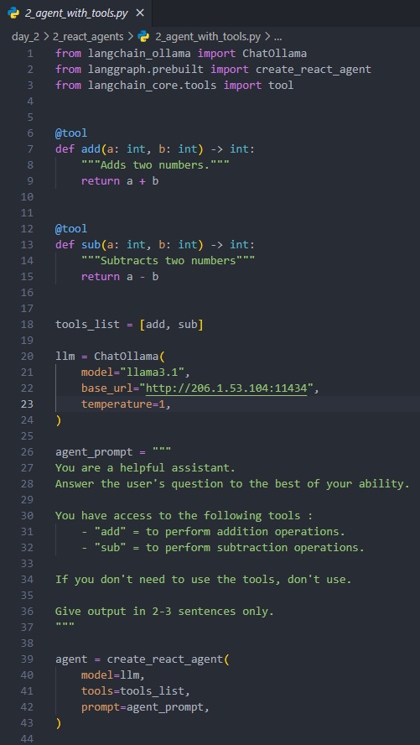
Tool calling by ReAct Agents
Define tools.
Create a tools list.
Create ReAct Agent and pass tools list to it.
Job Done!!
Notes:
“Now that we’ve seen ReAct, let’s put tools in the loop.
Step 1 — Define tools. I’m adding two tiny, deterministic tools: add and sub. They’re perfect for demos because we can instantly verify correctness.
Step 2 — Create a tools list. We bundle the tools into tools_list = [add, sub].
Step 3 — Create a ReAct agent and pass the tools. Same as before, but now the agent can choose to call add/sub or just answer directly. In theory: math → tools, chit-chat → no tools. Let’s run it.”
“Notice something odd? For ‘tell me a joke’ or ‘what is today’s date?’, llama3.1 still tries to call a math tool. This is common: some models are tool-happy—they over-call because (a) the prompt gives tools high salience, (b) temperature is non-zero, or (c) the model was trained to eagerly use tools when available.
This wasn’t just a fluke — it’s a pattern. Some models are what we call tool-happy. They overuse tools because:
the system prompt makes tools really salient,
temperature isn’t zero, or
the model was trained to eagerly grab tools when available.
Let’s switch to qwen3:8b and try the same inputs. If it behaves, you’ll see it answer the joke/date without touching the tools. If it still over-calls, no worries—that’s why we add a small router or guardrail. I’ll show both fixes.”
That’s why it tried to subtract instead of just saying: ‘Sorry, I can’t check the time.’"*
Fail safes :
“See how the agent called add for a joke? That’s tool bias. Two quick levers: lower temperature and tighten the tool policy in the system prompt.”
“If a different model behaves better, that’s a reminder: tool use depends on the model’s training. Always test with your toolkit.”
“For production, we combine both: a stricter prompt and a lightweight router so user experience doesn’t depend on model mood.”

Slide 15

🤝 Agents Talking to Agents
🌐 Autonomous Workflows
🧩 Specialist Agents
🔄 Coordination & Orchestration
🚀 From Single Tool Use to Entire Missions
Notes:
Now that you've met LLMs and Agents, here’s where it gets really exciting… If you had an AI Agent right now, what would you want it to do for you?
Those are perfect use cases. And the best part? With LangChain and tools, you can build those agents yourself.
Agents are not just answering questions.
They’re deciding what actions to take,
in what order, and even coordinating with other agents to help you reach your goal. That’s where AI starts becoming truly useful — not just as a chatbot, but as a problem-solver."
Speaker Notes (after content reveal):
(Show bullets one by one, build suspense)
"🤝 Imagine agents talking to agents. 🌐 Imagine autonomous workflows — an agent that doesn’t just answer, but executes. 🧩 Imagine specialist agents — one for math, one for research, one for scheduling — each expert in its field. 🔄 Then, imagine them coordinating, orchestrating, handing tasks to each other. 🚀 Suddenly, you go from single tool use to entire missions."
(Pause, look around the room) "Feels like science fiction, right? Well… picture’s still half-finished. In the next session, we’ll paint the rest of it."

Slide 16
Questions?
Notes:
Alright, I’ll pause here — what questions do you have? What ideas are you curious about? What would you want to build?

Slide 17
Knowledge Check
->
Why should we give tools to an LLM?
->
Explain the flow of ReAct pattern.
->
Why might a model call a tool even if it’s not needed.
Notes:
Last question : Some models are “tool-happy” — they overuse tools due to prompt wording, training biases, or higher temperature settings, even when a direct answer would be better.

Slide 18
End of Chapter 2!
Giving agents tools : Okay ! This was a questionable decision. 🤖😬
Notes:
Today you all played the part of ReAct detectives — thinking, acting, and observing right alongside the agent.
The tools were our gadgets, the LLM was our partner, and now the case is temporarily closed.
But there’s a bigger investigation coming: multi-agent missions.
Thanks for being curious, engaged, and not afraid to poke the code.”
You thought like detectives, acted like agents, and observed your way through tool use and ReAct.
The investigation isn’t over, though. Next time, we’ll open up bigger cases — agents working together, coordinating missions, and taking on challenges no single agent could handle alone.
Until then… thanks for playing detective with me.

